Slide 1
Exception Handling in Spring REST

Slide 2
Agenda:
What is Exception
Benefit of Exception Handling in REST using Spring
How to Handle Exception
Standardize REST API Error
Common HTTP Status Code
Code Sample

Slide 3
Exception:
An exception is an event, which occurs during the execution of a program, that disrupts the normal flow of the program's instructions.

Slide 4
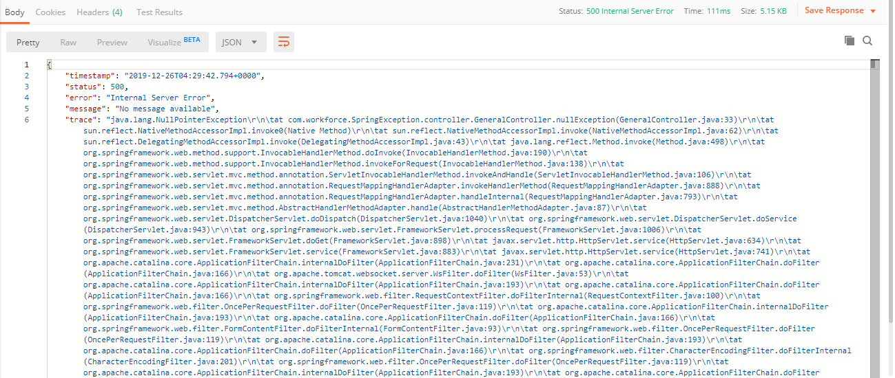
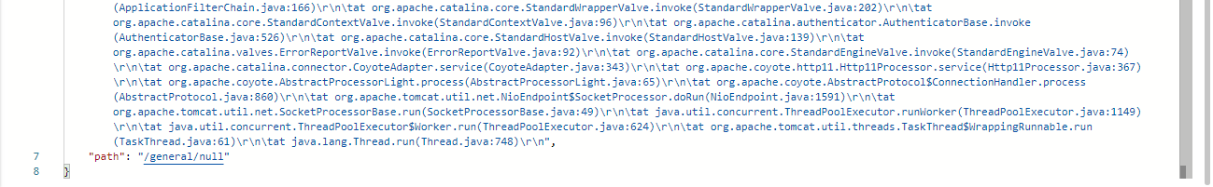
Benefit
Without Exception Handling in REST

Slide 5
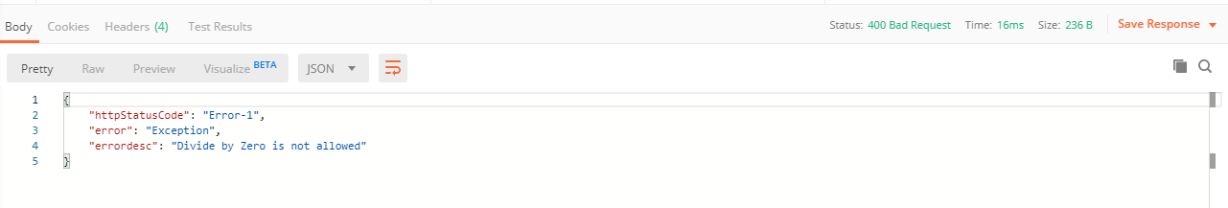
With Exception handling in REST

Slide 6
Handle Exception using @ControllerAdvice
Controller1
Service 1
Exception occurred
HTTP Call
Response
REST API
Client
Exception occurred
HTTP Call
Controller2
Service 2
Response
Exception Response
Exception Handler

Slide 7
Standardize REST API Error
In an effort to standardize REST API error handling, the IETF devised RFC 7807, which creates a generalized error-handling schema. https://tools.ietf.org/html/rfc7807
Implementation : https://github.com/zalando/problem-spring-web
Media Type:- “application/problem+json” or “application/problem+xml”
Format:-
"type" (string) - A URI reference that identifies the problem type. This specification encourages that, when dereferenced, it provide human-readable documentation for the problem type. When this member is not present, its value is assumed to be "about:blank".
"title" (string) - A short, human-readable summary of the problem type. It SHOULD NOT change from occurrence to occurrence of the problem, except for purposes of localization.
"status" (number) - The HTTP status code generated by the origin server for this occurrence of the problem.
"detail" (string) - A human-readable explanation specific to this occurrence of the problem.
"instance" (string) - A URI reference that identifies the specific occurrence of the problem. It may or may not yield further information if dereferenced.
Content-Type: application/problem+json"
{
"type" : "http://localhost:21020/problems/person-not-found",
"title" : "Person is not found",
"status" : 404,
"detail" : "Person with identifier '1' is not found",
"instance" : "http://localhost:21020/api/people/1",
}

Slide 8
Common HTTP Status Code
200 OK
301 Moved Permanently
304 Not Modified
400 Bad Request
401 Unauthorized
403 Forbidden
404 Not Found
405 Method Not Allowed
500 Internal Server Error
502 Bad Gateway
503 Service Unavailable

